Slide 1
CPT-S 415
Big Data
Yinghui Wu
EME B45

Slide 2
CPT-S 415
Big Data
Parallel models
beyond MapReduce
Vertex-centric models
  Pregel (BSP)
  GraphLab
GRAPE
Notes:
Object.

Slide 3
Inefficiency of MapReduce
<k1, v1>
<k1, v1>
<k1, v1>
<k1, v1>
mapper
mapper
mapper
<k2, v2>
<k2, v2>
<k2, v2>
reducer
reducer
<k3, v3>
<k3, v3>
reasons?

Slide 4
Iterative Algorithms
Map-Reduce not efficiently express iterative algorithms:
Iterations
Data
Data
Data
Data
CPU 1
CPU 1
CPU 1
Data
Data
Data
Data
Slow
Processor
Data
Data
Data
Data
CPU 2
CPU 2
CPU 2
Data
Data
Data
Data
Blocking: Reduce does not start until all Map tasks are completed
Data
Data
Data
Data
CPU 3
CPU 3
CPU 3
Data
Data
Data
Data
Data
Data
Data
Data
Barrier
Barrier
Barrier

Slide 5
Iterative MapReduce
Only a subset of data needs computation:
Iterations
Data
Data
Data
Data
CPU 1
CPU 1
CPU 1
Data
Data
Data
Data
Data
Data
Data
Data
CPU 2
CPU 2
CPU 2
Data
Data
Data
Data
Data
Data
Data
Data
CPU 3
CPU 3
CPU 3
Data
Data
Data
Data
Intermediate results shipping: all to all
Data
Data
Data
Data
Barrier
Barrier
Barrier

Slide 6
Iterative MapReduce
System is not optimized for iteration:
Iterations
Data
Data
Data
Data
CPU 1
CPU 1
CPU 1
Data
Data
Data
Data
Data
Data
Data
Data
CPU 2
CPU 2
CPU 2
Startup Penalty
Disk Penalty
Startup Penalty
Disk Penalty
StartupPenalty
Data
Data
Disk Penalty
Data
Data
Data
Data
Data
Data
CPU 3
CPU 3
CPU 3
Data
Data
Data
Data
Write to disk and read from disk in each step, although the data does not change in loops
Data
Data
Data
Data

Slide 7
The need for parallel models beyond MapReduce
MapReduce:
  Inefficiency: blocking, intermediate result shipping (all to all); write to disk and read from disk in each step, even for invariant data in a loop
  Does not support iterative graph computations:
    External driver
    No mechanism to support global data structures that can be accessed and updated by all mappers and reducers
  Support for incremental computation?
  Have to re-cast algorithms in MapReduce, hard to reuse existing (incremental) algorithms
  General model, not limited to graphs
Can we do better for graph algorithms?

Slide 8

Map-Reduce for Data-Parallelism
Data-Parallel Graph-Parallel
Map Reduce
Graph parallel models
Feature
Extraction
Cross
Validation
Label Propagation
Lasso
Belief
Propagation
Kernel
Methods
Computing Sufficient
Statistics
Tensor
Factorization
PageRank
Deep Belief
Networks
Neural
Networks

Slide 9
BSP model
adapted from Michael C.Scherger

Slide 10
Bulk Synchronous Parallelism
BSP is based on the Synchronizer Automata (Leslie Valiant, Harvard University)
The model consists of:
  A set of processor-memory pairs.
  A communications network that delivers messages in a point-to-point manner.
  A mechanism for the efficient barrier synchronization for all or a subset of the processes.
Node (w)
Node
Node
P
M
P
M
P
M
Barrier (l)
Communication Network (g)

Slide 11
Bulk Synchronous Parallel Model (BSP)
Leslie G. Valiant: A Bridging Model for Parallel Computation. Commun. ACM 33 (8): 103-111 (1990)
analogous to MapReduce rounds
Processing: a series of supersteps
Vertex: computation is defined to run on each vertex
Superstep S: all vertices compute in parallel; each vertex v may
  receive messages sent to v from superstep S – 1;
  perform some computation: modify its states and the states of its outgoing edges
  Send messages to other vertices ( to be received in the next superstep)
Message passing
Vertex-centric, message passing

Slide 12
BSP Programming Style
Vertical Structure
  Sequential composition of “supersteps”.
    Local computation
    Process Communication
    Barrier Synchronization
Horizontal Structure
  Concurrency among a fixed number of virtual processors.
  Processes do not have a particular order.
  Locality plays no role in the placement of processes on processors.
  p = number of processors.
Virtual Processors
Local
Computation
Global
Communication
Barrier
Synchronization

Slide 13
Barrier Synchronization
“Often expensive and should be used as sparingly as possible.”
Developers of BSP claim that barriers are not as expensive as they are believed to be in high performance computing folklore.
The cost of a barrier synchronization has two parts.
  The cost caused by the variation in the completion time of the computation steps that participate.
  The cost of reaching a globally-consistent state in all processors.

Slide 14
Vertex-centric models

Slide 15
Pregel: think like a vertex
Input: a directed graph G
  Each vertex v: a node id, and a value
  Edges: contain values (associated with vertices)
Vertex: modify its state/edge state/edge sets (topology)
Supersteps: within each, all vertices compute in parallel
Termination:
  Each vertex votes to halt
  When all vertices are inactive and no messages in transit
Synchronization: supersteps

Slide 16
















Pregel (Giraph)
Bulk Synchronous Parallel Model:
Compute
Communicate
Barrier

Slide 17
Example: maximum value
3
6
2
1
Superstep 0
message passing
6
6
2
6
Superstep 1
6
6
6
6
Superstep 2
6
6
6
6
Superstep 3
Shaded vertices: voted to halt

Slide 18
Vertex API
Template (VertexValue, EdgeValue, MessageValue)
Class Vertex {
  void Compute (MessageIterator: msgs)
  const vertex_id;
  const superstep();
  const VertexValue& GetValue();
  VertexValue* MutableValue();
  OutEdgeIterator GetOutEdgeIterator();
  void SendMessageTo (dest_vertex, MessageValue& message);
  void VoteToHalt();
  }
User defined
All messages received
Iteration control
Vertex value: mutable
Outgoing edges
Message passing: messages can be sent to any vertex whose id is known
Think like a vertex: local computation

Slide 19
PageRank
The likelihood that page v is visited by a random walk:
  α (1/|V|) + (1 - α) Σ_(u ∈ L(v)) P(u)/C(u)
random jump
following a link from other pages
Recursive computation: for each page v in G,
    compute P(v) by using P(u) for all u ∈ L(v)
  until
    converge: no changes to any P(v)
    after a fixed number of iterations
A BSP algorithm?

Slide 20
PageRank in Pregel
PageRankVertex {
  Compute (MessageIterator: msgs) {
  if (superstep() >= 1)
  then sum := 0;
  for all messages in msgs do
  *MutableValue() := α /NumVertices() + (1- α) sum;
  }
  if (superstep() < 30)
  then n := GetOutEdgeIterator().size();
  sendMessageToAllNeighbors(GetValue() / n);
  else VoteToHalt();
  }
iterations
  α (1/|V|) + (1 - α) Σ_(u ∈ L(v)) P(u)
Assume 30 iterations
  α (1/|V|) + (1 - α) Σ_(u ∈ L(v)) P(u)/C(u)
Pass revised rank to its neighbors
VertexValue: the current rank

Slide 21
Dijkstra’s algorithm for distance queries
Distance: single-source shortest-path problem
  Input: A directed weighted graph G, and a node s in G
  Output: The lengths of shortest paths from s to all nodes in G
Dijkstra (G, s, w):
  for all nodes v in V do
    d[v] ← ∞; ←
  d[s] ← 0; Que ← V;
  while Que is nonempty do
    u ← ExtractMin(Que);
    for all nodes v in adj(u ) do
      if d[v] > d[u] + w(u, v) then d[v] ← d[u] + w(u, v);
Use a priority queue Que; w(u, v): weight of edge (u, v); d(u): the distance from s to u
Extract one with the minimum d(u)
An algorithm in Pregel?

Slide 22
Distance queries in Pregel
Refer to the current node as u
ShortesPathVertex {
  Compute (MessageIterator: msgs) {
  if isSource(vertex_id( )
  then minDist := 0 else minDist := ∞;
  for all messages m in msgs do
  minDist := min(minDist, m.Value());
  if midDist < GetValue()
  then *MutableValue() := minDist;
  for all nodes v linked to from the current node u do
  SendMessageTo(v, minDist + w(u, v);
  VoteToHalt();
  }
aggregation
Messages: distances to u
MutableValue: the current distance
Pass revised distance to its neighbors
Think like a vertex

Slide 23
Combiner and Aggregation
Combine several messages intended for a vertex
  Provided that the messages can be aggregated (“reduced”) by using some associative and commutative function
  Reduce the number of messages
Each vertex can provide a value to an aggregator in any superstep S.
System aggregates these values (“reduce”)
The aggregated values are made available to all vertices in superstep S + 1.
Global data structures
optimization

Slide 24
Topology mutation
Function compute can add or remove vertices
Possible conflicts:
  Vertex 1 adds an edge to vertex 100
  Vertex 2 deletes vertex 100
  Vertex 1 creates a vertex 10 with value 10
  Vertex 2 also creates a vertex 10 with value 12
Handling conflicts:
  Partial order on operations: edge removal < vertex removal < vertex addition < edge addition
System: user specified
Extra power, yet increased complication

Slide 25
Pregel implementation
Vertices are assigned to machines: hash(vertex.id) mod N
Partitions can be user-specified, to co-locate all Web pages form the same site, for instance
Cross edges: minimize edges across partitions
  Sparsest Cut Problem
Master: coordinate a set of workers (partitions, assignments)
Worker: processes one or more partitions, local computation
  Know the partition function and partitions assigned to it
  All vertices in a partition are initially active
  Worker notifies master of the number of active vertices at the end of a superstep
Giraph, http://www.apache.org/dyn/closer.cgi/giraph
Master, worker

Slide 26
Fault tolerance
Checkpoints: mater instructs workers to save state to HDFS
  Vertex values
  Edge values
  Incoming messages
Master saves aggregated values to disk
Worker failure:
  detected by regular “ping” messages issued by the master (mark it failed after specified interval)
  Recovered by creating a new worker, with the state stored from previous checkpoint
recovery

Slide 27
The vertex centric model of GraphLab
No supersteps
Vertex: computation is defined to run on each vertex
All vertices compute in parallel
  Each vertex reads and writes to data on adjacent nodes or edges
Consistency: serialization
  Full consistency: no overlap for concurrent updates
  Edge consistency: exclusive read-write to its vertex and adjacent edges; read only to adjacent vertices
  Vertex consistency: all updates in parallel (sync operations)
Asynchronous: all vertices
asynchronous
https://dato.com/products/create/open_source.html
Machine learning, data mining

Slide 28
The GraphLab Framework
Graph Based
Data Representation
Update Functions
User Computation
Scheduler
Consistency Model

Slide 29
Data Graph
A graph with arbitrary data (C++ Objects) associated with each vertex and edge.
Graph:
Social Network
Vertex Data:
User profile text
Current interests estimates
Edge Data:
Similarity weights

Slide 30
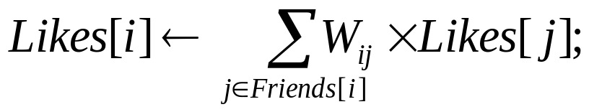
Update Functions
An update function is a user defined program which transforms the data in the scope of the vertex when applied to a vertex
label_prop(i, scope){
// Get Neighborhood data
(Likes[i], W_{ij}, Likes[j]) ←scope;
// Update the vertex data
// Reschedule Neighbors if needed
if Likes[i] changes then
reschedule_neighbors_of(i);
}

Slide 31
The Scheduler
The scheduler determines the order that vertices are updated.
CPU 1
b
c
d
a
b
c
b
a
Scheduler
e
f
e
f
g
i
h
i
j
h
i
j
k
CPU 2
The process repeats until the scheduler is empty.

Slide 32





Ensuring Race-Free Code
How much can computation overlap?
Pagerank(scope) {
}
Notes:
But if two adjacent vertices are updated simultaneously…. We could get a clash on the center edge.
The result on the center edges could become inconsistent. For instance, the left vertex could write the blue histogram to the edge.
The right.
But due to the collision, it is possible for the final value can be very wrong.

Slide 33




GAS Decomposition
Gather (Reduce)
Apply
Scatter
Accumulate information about neighborhood
Apply the accumulated
value to center vertex
Update adjacent edges
and vertices.
User Defined:
User Defined:
User Defined:
Gather( ) → Σ
Apply( , Σ) →
Scatter( ) →
Y
Y
Y’
Y’
Σ₁ + Σ₂ → Σ₃
Σ
Y’
Y
Y’
Y
Update Edge Data &
Activate Neighbors
Parallel
Sum
+
+ … + →
Y
Y
Y

Slide 34
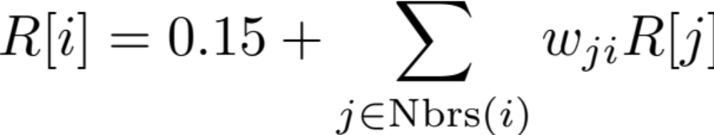
PageRank in PowerGraph
PowerGraph_PageRank(i)
Gather( j → i ) : return w_{ji} * R[j]
sum(a, b) : return a + b;
Apply(i, Σ) : R[i] = 0.15 + Σ
Scatter( i → j ) :
if R[i] changed then trigger j to be recomputed

Slide 35
Vertex-centric models vs. MapReduce
Vertex centric: think like a vertex; MapReduce: think like a graph
Vertex centric: maximize parallelism – asynchronous, minimize data shipment via message passing; support iterations
  MapReduce: inefficiency caused by blocking; distributing intermediate results (all to all), unnecessary write/read; does not provide a mechanism to support iteration
Vertex centric: limited to graphs; MapReduce: general
Lack of global control: ordering for processing vertices in recursive computation, incremental computation, etc
  New programming models, have to re-cast algorithms in MapReduce, hard to reuse existing (incremental) algorithms
Can we do better?

Slide 36
Pregel vs GraphLab
Distributed system models
  Asynchronous model and Synchronous model
  Well known tradeoff between two models
    Synchronous: concurrency-control/failures easy, poor perf.
    Asynchronous: concurrency-control/failures hard, good perf.
Pregel is a synchronous system
  No concurrency control, no worry of consistency
  Fault-tolerance, check point at each barrier
GraphLab is asynchronous system
  Consistency of updates harder (sequential, vertex)
  Fault-tolerance harder (need a snapshot with consistency)

Slide 37
From Vertex-centric models to Graph-centric models

Slide 38
Querying distributed graphs
Given a big graph G, and n processors S1, …, Sn
G is partitioned into fragments (G1, …, Gn)
G is distributed to n processors: Gi is stored at Si
Parallel query answering
Input: G = (G1, …, Gn), distributed to (S1, …, Sn), and a query Q
Output: Q(G), the answer to Q in G
Each processor Si processes its local fragment Gi in parallel
G
Q( )
How does it work?
…
Q( )
Q( )
Q( )
G_{n}
G₁
G₂
Dividing a big G into small fragments of manageable size

Slide 39
GRAPE (GRAPh Engine)
manageable sizes
Divide and conquer
partition G into fragments (G1, …, Gn), distributed to various sites
evaluate Q on smaller Gi
upon receiving a query Q,
  evaluate Q( Gi ) in parallel
  collect partial answers at a coordinator site, and assemble them to find the answer Q( G ) in the entire G
Each machine (site) Si
processes the same query Q,
uses only data stored in its local fragment Gi
data-partitioned parallelism

Slide 40
Partial evaluation
compute f( x ) ⇒ f( s, d )
the part of known input
yet unavailable input
conduct the part of computation that depends only on s
generate a partial answer
a residual function
at each site, Gi as the known input
Partial evaluation in distributed query processing
  evaluate Q( Gi ) in parallel
  collect partial matches at a coordinator site, and assemble them to find the answer Q( G ) in the entire G
Gj as the yet unavailable input
as residual functions
The connection between partial evaluation and parallel processing
Notes:
Computing graph matches in batch style is expensive.
We find new matches by making maximal use of previous computation, without paying the price of the high complexity of graph pattern matching.

Slide 41
Coordinator
Each machine (site) Si is either
a coordinator
a worker: conduct local computation and produce partial answers
Coordinator: receive/post queries, control termination, and assemble answers
  Upon receiving a query Q
    post Q to all workers
    Initialize a status flag for each worker, mutable by the worker
  Terminate the computation when all flags are true
    Assemble partial answers from workers, and produce the final answer Q(G)
Termination, partial answer assembling

Slide 42
Workers
Worker: conduct local computation and produce partial answers
upon receiving a query Q,
  evaluate Q( Gi ) in parallel
  send messages to request data for “border nodes”
use local data Gi only
With edges to other fragments
Incremental computation
Incremental computation: upon receiving new messages M
  evaluate Q( Gi + M) in parallel
set its flag true if no more changes to partial results, and send the partial answer to the coordinator
This step repeats until the partial answer at site Si is ready
Local computation, partial evaluation, recursion, partial answers

Slide 43
Reachability and regular path queries
Reachability
  Input: A directed graph G, and a pair of nodes s and t in G
  Question: Does there exist a path from s to t in G?
O(|V| + |E|) time
Regular path
  Input: A node-labelled directed graph G, a pair of nodes s and t in G, and a regular expression R
  Question: Does there exist a path p from s to t such that the labels of adjacent nodes on p form a string in R?
O(|G| |R|) time
Parallel algorithms?
Costly when G is big

Slide 44
Reachability queries
Worker: conduct local computation and produce partial answers
upon receiving a query Q,
  evaluate Q( Gi ) in parallel
  send messages to request data for “border nodes”
With edges to other fragments
Boolean formulas as partial answers
  For each node v in Gi, a Boolean variable X_{v}, indicating whether v reaches destination t
  The truth value of X_{v} can be expressed as a Boolean formula over X_{vb}
Border nodes in Gi
Local computation: computing the value of X_{v} in Gi

Slide 45

Boolean variables
Locally evaluate each qr(v,t) in Gi in parallel:
for each in-node v’ in Fi, decides whether v’ reaches t; introduce a Boolean variable to each v’
Partial answer to qr(v,t): a set of Boolean formula, disjunction of variables of v’ to which v can reach
qr(v,t)
= X_{v1}’ or … or X_{vn}’
v
qr(v,v’)
X_{v}’ = qr(v’,t)
v’
t
t
Partial evaluation by introducing Boolean variables
Notes:
If t is in Fi, qr(v,t) is locally evaluated
otherwise, qr(v,t) = qr(v,v’) AND qr(v’,t)
qr(v,t) is true iff there is a virtual node v’ s.t. qr(v,v’) and qr(v’,t) are true.
Instead of waiting for the answer of qr(v’,t), we introduce a …

Slide 46
Distributed reachability: assembling
Coordinator: Assemble partial answers from workers, and produce the final answer Q(G)
Xs = Xv
Only V_{f} , the set of border nodes in all fragments
X_{v} = X_{v’’} or X_{v’}
Collect the Boolean equations at coordinator
solve a system of linear Boolean equation by using a dependency graph
qr(s,t) is true if and only if X_{s} = true in the equation system
X_{v}’ = Xt
X_{v’’} = false
O(|V_{f}|)
Xt = 1
Assembling partial answers

Slide 47





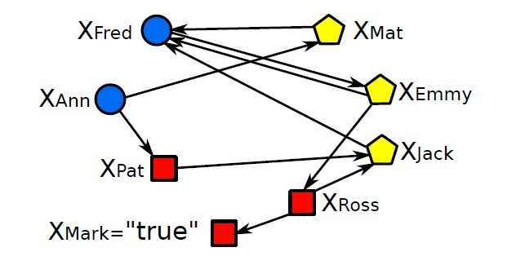

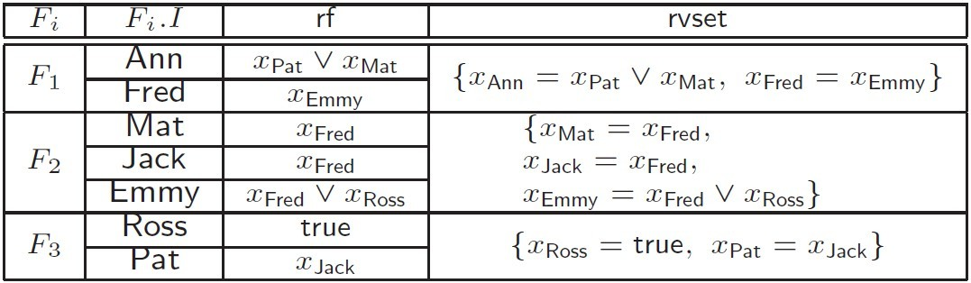




Example
Dispatch Q to fragments (at Sc)
Partial evaluation: generating Boolean equations (at Gi)
Assembling: solving equation system (at Sc)
Q
Mat,"HR"
Fred, "HR"
Walt, "HR"
Emmy,"HR"
G₂
G₁
Ann
Q
Q
Q
Q
Sc
Jack,"MK"
Bill,"DB"
Mark
Ross,"HR"
G₃
Pat,"SE"
Tom,"AI"
No messages between different fragments

Slide 48
Reachability queries in GRAPE
upon receiving a query Q,
  evaluate Q( Gi ) in parallel
  collect partial answers at a coordinator site, and assemble them to find the answer Q( G ) in the entire G
G_{m}: the largest fragment
Complexity analysis
Parallel computation: in O(|V_{f}||G_{m}|) time
One round: no incremental computation is needed
Data shipment: O(|V_{f}|²), to send partial answers to the coordinator; no message passing between different fragments
speedup? |G_{m}| = |G|/n
Approximation algorithm
. Rahimian, A. H. Payberah, S. Girdzijauskas, M. Jelasity, and S. Haridi. Ja-be-ja: A distributed algorithm for balanced graph partitioning. Technical report, Swedish Institute of Computer Science, 2013
Complication: minimizing V_{f}? An NP-complete problem.
Think like a graph

Slide 49
Graph pattern matching by graph simulation
Input: A directed graph G, and a graph pattern Q
Output: the maximum simulation relation R
Maximum simulation relation: always exists and is unique
  If a match relation exists, then there exists a maximum one
  Otherwise, it is the empty set – still maximum
  Complexity: O((| V | + | V_{Q} |) (| E | + | E_{Q}| )
  The output is a unique relation, possibly of size |Q||V|
A parallel algorithm in GRAPE?

Slide 50
Coordinator
Given a big graph G, and n processors S1, …, Sn
G is partitioned into fragments (G1, …, Gn)
G is distributed to n processors: Gi is stored at Si
Coordinator: Upon receiving a query Q
post Q to all workers
Initialize a status flag for each worker, mutable by the worker
Boolean formulas as partial answers
  For each node v in Gi and each pattern node u in Q, a Boolean variable X(u, v), indicating whether matches u
  The truth value of X(u, v) can be expressed as a Boolean formula over X(u’, v’), for border nodes v’ in V_{f}
Again, Boolean formulas

Slide 51
Worker: initial evaluation
Worker: conduct local computation and produce partial answers
upon receiving a query Q,
  evaluate Q( Gi ) in parallel
  send messages to request data for “border nodes”
use local data Gi only
Local evaluation
  Invoke an existing algorithm to compute Q(Gi)
  Minor revision: incorporating Boolean variables
With edges from other fragments
Messages:
  For each node to which there is an edge from another fragment Gj, send the truth value of its Boolean variable to Gj
Partial evaluation: using an existing algorithm

Slide 52
Worker: incremental evaluation
Recursive computation
Repeat until the truth values of all Boolean variables in Gi are determined
Use an existing incremental algorithm
  evaluate Q( Gi + M) in parallel
Messages from other fragments
set its flag true and send partial answer Q(Gi) to the coordinator
  Termination:
Partial answer assembling
Coordinator:
Terminate the computation when all flags are true
The union of partial answers from all the workers is the final answer Q(G)
Incremental computation, recursion, termination

Slide 53
Graph simulation in GRAPE
Input: G = (G1, …, Gn), a pattern query Q
Output: the unique maximum match of Q in G
Performance guarantees
  Response time: O((|V_{Q}| + |V_{m}|) (|E_{Q}| + |E_{m}|) |V_{Q}| |V_{f}|)
  the total amount of data shipped is in O( |V_{f}| |V_{Q}| )
where
  Q = (V_{Q}, E_{Q})
  G_{m} = (V_{m}, E_{m}): the largest fragment in G
  V_{f}: the set of nodes with edges across different fragments
  in contrast graph simulation: O((| V | + | V_{Q} |) (| E | + | E_{Q}| )
small
|G|/n
with 20 machines, 55 times faster than first collecting data and then using a centralized algorithm
parallel query processing with performance guarantees
Notes:
18
We have proposed an algorithm to demonstrate the benefits of incremental matching, based on locality property. Upon updates to the data graphs, we only need to consider the subgraphs induced by the nodes and edges that are within k hops of the updated edges, where k is the diameter of the pattern graph Gp.

Slide 54
GRAPE vs. other parallel models
Reduce unnecessary computation and data shipment
  Message passing only between fragments, vs all-to-all (MapReduce) and messages between vertices
  Incremental computation: on the entire fragment;
  Think like a graph, via minor revisions of existing algorithms;
    no need to to re-cast algorithms in MapReduce or BSP
    Iterative computations: inherited from existing ones
Flexibility: MapReduce and vertex-centric models as special cases
  MapReduce: a single Map (partitioning), multiple Reduce steps by capitalizing on incremental computation
  Vertex-centric: local computation can be implemented this way
Implement a GRAPE platform?

Slide 55
Summing up

Slide 56
Summary and review
What is the MapReduce framework? Pros? Pitfalls?
Develop algorithms in MapReduce
What are vertex-centric models for querying graphs? Why do we need them?
What is GRAPE? Why does it need incremental computation? How to terminate computation in GRAPE?
Develop algorithms in vertex-centric models and in GRAPE.
Compare the four parallel models: MapReduce, PBS, vertex-centric, and GRAPE

Slide 57
Regular path queries in GRAPE
Adding a regular expression R
Regular path queries
  Input: A node-labelled directed graph G, a pair of nodes s and t in G, and a regular expression R
  Question: Does there exist a path p from s to t such that the labels of adjacent nodes on p form a string in R?
Boolean formulas as partial answers
  Treat R as an NFA (with states)
  For each node v in Gi, a Boolean variable X(v, w), indicating whether v matches state w of R and reach destination t
  X(v, f): the final state f of NFA, for destination node t
Incorporating the state of NFA for R

Slide 58
Boolean variables
|Vq|: the number of states in R
For each node v in Gi, assign v. rvec: a vector of O(|Vq|) Boolean formulas, each entry v.rvec[w] denotes if v matches state w
introduce a Boolean variable X(v’,w) for each border node v’ of Gi and a state w in Vq, denoting if v’ matches w
Partial answer to qrr(s,t): a set of Boolean formula from each in-nodes of Fi
f₁₁
f₁₂
…
f_{1k}
v₁
v₂
f_{1v’}
f_{2v’}
…
f_{kv’}
v’
t
X(v’,w)
v_{q}
…
w_{q}
t
R
Partial answers as Boolean formulas
20

Slide 59
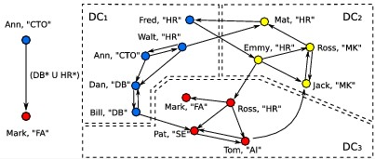
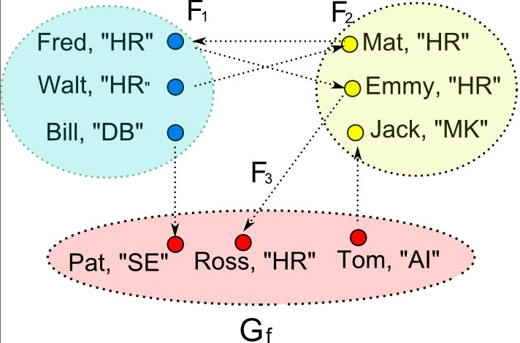
Regular path queries
Fragment F
"virtual nodes" of F₁
Ann
DB
HR
cross edges
Mark
pattern
fragment graph

Slide 60


Regular reachability queries
Boolean variables for “virtual nodes”
reachable from Ann
Ann
Fred, HR
X(Mat, HR)
Ann
Mat, HR
F₂
Walt, HR
Emmy, HR
F₁
Bill,DB
X(Emmy, HR)
Assemble partial answers: solve the system of Boolean equations
DB
HR
false
F₃
Mark, Mark
Pat, SE
Ross, HR
true
Only the query and the Boolean equations need to be shipped
X(Pat, DB)
X(Ross, HR)
Mark
Each site is visited once
F₁: Y(Ann,Mark) = X(Pat, DB) X(Mat, HR)
X(Fred, HR) = X(Emmy, HR)
Y(Ann,Mark)
= true
F₂: X(Emmy, HR) = X(Ross, HR)
X(Mat, HR) = X(Fred, HR)
Boolean equations
at each site, in parallel
F₃: X(Pat, DB) = false, X(Ross, HR) = true
The same query is partially evaluated at each site in parallel

Slide 61
Regular path queries in GRAPE
upon receiving a query Q,
  evaluate Q( Gi ) in parallel
  collect partial answers at a coordinator site, and assemble them to find the answer Q( G ) in the entire G
G_{m}: the largest fragment
Complexity analysis
Parallel computation: in O((|V_{f}|²+|G_{m}|)|R|² ) time
One round: no incremental computation is needed
Data shipment: O(|R|² |V_{f}|²), to send partial answers to the coordinator; no message passing between different fragments
Speedup: |G_{m}| = |G|/n, and R is small in practice
Think like a graph: process an entire fragment

